Slide 1



Optimizing Your PsyCap Mindset ™
PSEWEB: August 13, 2018

Slide 2

re·sil·ience rəˈzilyəns/
noun
1. the capacity to recover quickly from difficulties; toughness.
2. the ability of a substance or object to spring back into shape; elasticity.

Slide 3
Why Resilience?
Setbacks/Obstacles/Challenges
Changing landscape (jobs + challenges)
Focus: Building resilient organizations (2008)
Focus: Building personal resilience

Slide 4
Today’s Conversation
My Story
Kahoot!: Let’s get to know each other
Psychological Capital
Hope, Efficacy, Resilience + Optimism
Happiness / Well-being

Slide 5
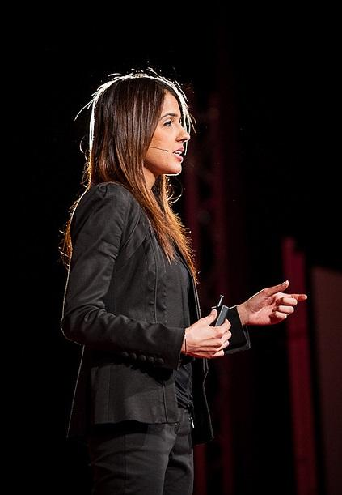
Introduction
My Current Worldview:
Entrepreneur
Learning Architect + Educator
PhD: Developing Competencies
Forbes Contributor
Author + Speaker I love what I do.

Slide 6

KAHOOT.IT Game PIN: On Screen
Notes:
Kahoot
rbillan
Education1

Slide 7
Introduction to Psychological Capital (PsyCap)
Fred Luthans: Rooted in Positive Organizational Behaviour
PsyCap is characterized by: (1) making positive attributions (optimism) about succeeding now and in the future; (2) persevering toward goals (hope) in order to succeed; (3) having confidence (efficacy) to take on and put in the necessary effort to succeed at challenging tasks; and (4) having the resilience to bounce back from adversity to attain success (Luthans, Youssef and Avolio, 2007)

Slide 8
Hope
Based on Charles Synder’s work in Hope Theory

Slide 9
Hope Theory + Goal Setting
Long-term study by Charles Synder showed that academic success was directly related to the strength of one trait: Hope
Hope is defined as the perceived capability to derive pathways to desired goals, and motivate oneself via agency thinking to use those pathways.
Hope is based on three essential factors: Goals, Will-Power & Way-Power.

Slide 10
Hope Theory + Goal Setting
Goal directed thinking: ability to create clear and meaningful goals (communicate these goals).
Will-Power: grit and determination (belief is important).
Way-Power: ability to imagine different strategies to achieve a goal .

Slide 11

Hope Theory + Goal Setting
How we define, describe and experience ‘happiness’ or ‘success’ is personal.
Our potential story: we live out the story we have created for ourselves.
Goals: this is about you.

Slide 12
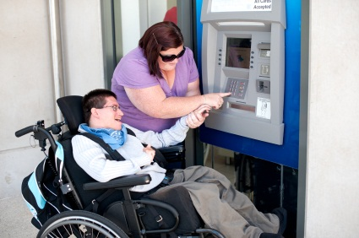
Can he drive a car on his own?

Slide 13
How can he drive a car on his own?

Slide 14

Consider
What is your goal?
Why is this important to you? (clear, meaningful and provides motivation)
How will you get there?
The question is not “can I do this?”, it’s “how can I do this?”

Slide 15

Self-Actualization
Where do you find meaning and purpose?
Example: Grade 7/8 Students

Slide 16
Who Do You Want To Be When You Grow Up?
I want to help encourage others and make them believe in themselves that they can accomplish anything.
I want to be able to look back on what I achieved and be proud of the things I did to help others.
I would like to be someone who is very confident because I am shy…I want that voice to say I’m here.
I want to be the reason some people change.

Slide 17
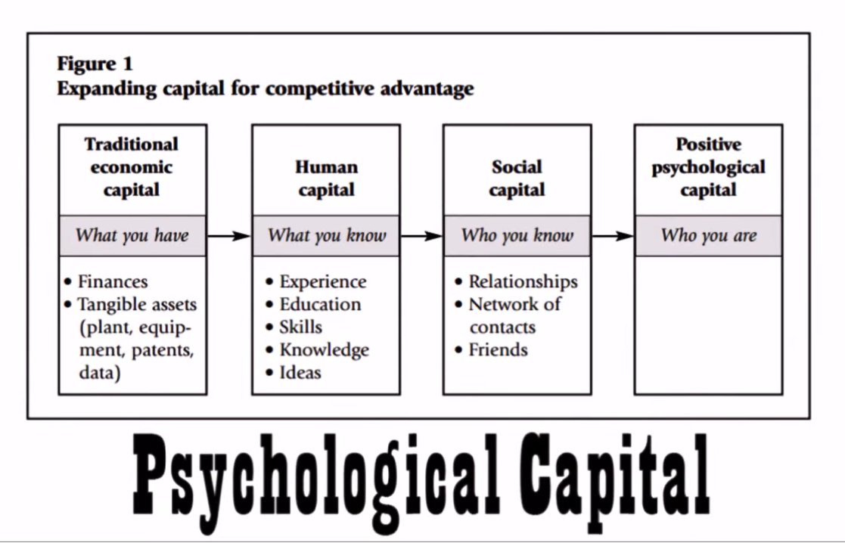
Psychological Capital: Competitive Advantage
Source: https://www.youtube.com/watch?v=_ws3cZVZl-k

Slide 18
“To have goals is to have hope.” – Author Unknown

Slide 19
Efficacy
Based on Albert Bandura’s work in confidence

Slide 20
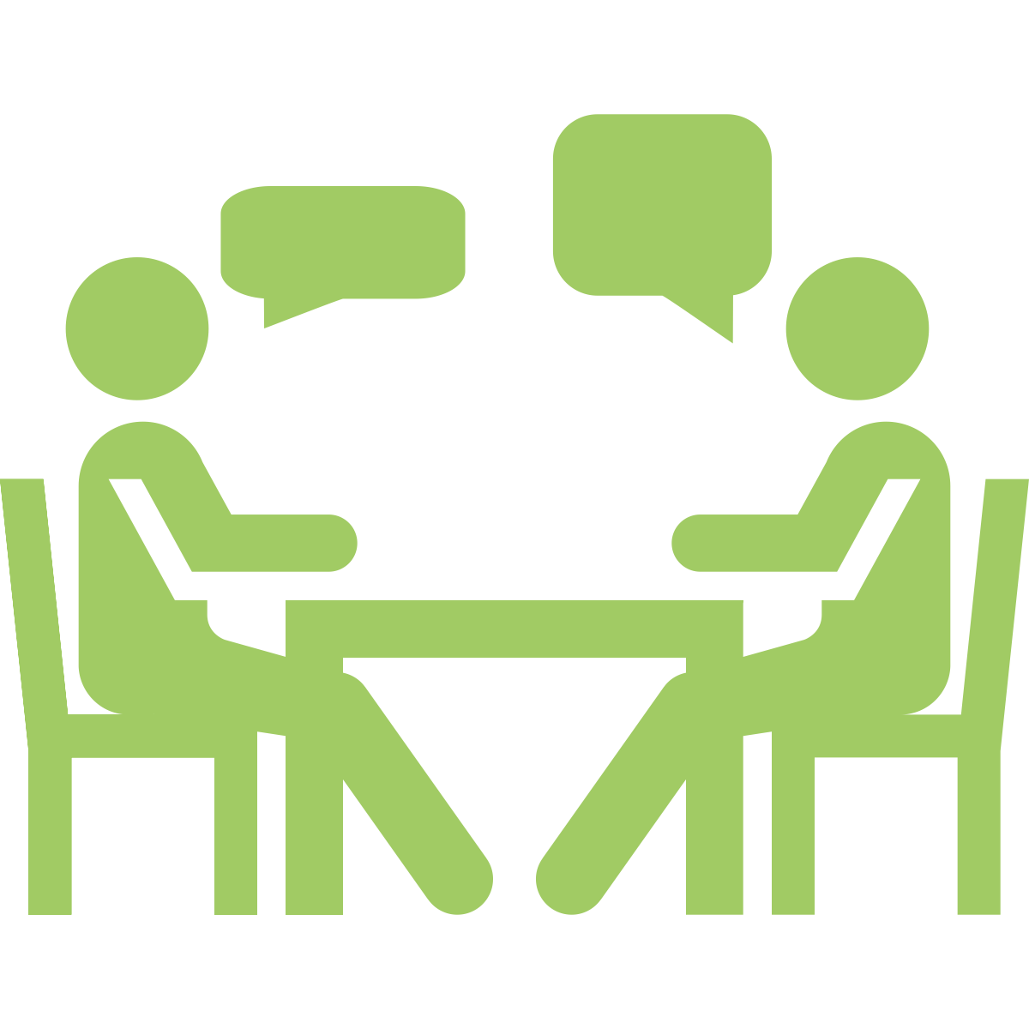
Question
When a friend/peer/sibling/partner has failed at something, what do you say to them?

Slide 21
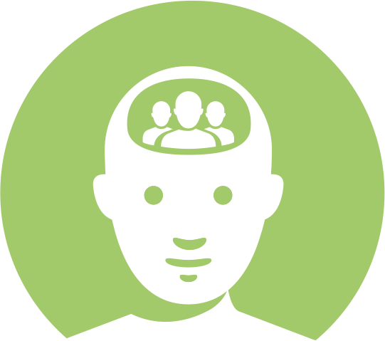
Question
When you’ve failed at something, what do you say to yourself?

Slide 22

Efficacy
Self-regard is associated with “general feelings of security, inner strength, self-assuredness, self-confidence, and self-adequacy” (Stein & Book, 2011, p. 68).
Self-Confidence: knowing that one can rely on their strengths and abilities in any given situation.
Importance of the language that we use. Self-talk is how we make our emotions real.

Slide 23
Question
How many of you believe that the opinions of others has an impact on how our friends/peers/siblings perceive themselves?

Slide 24
Question
Do the opinions of others have an impact on how you view yourself?

Slide 25
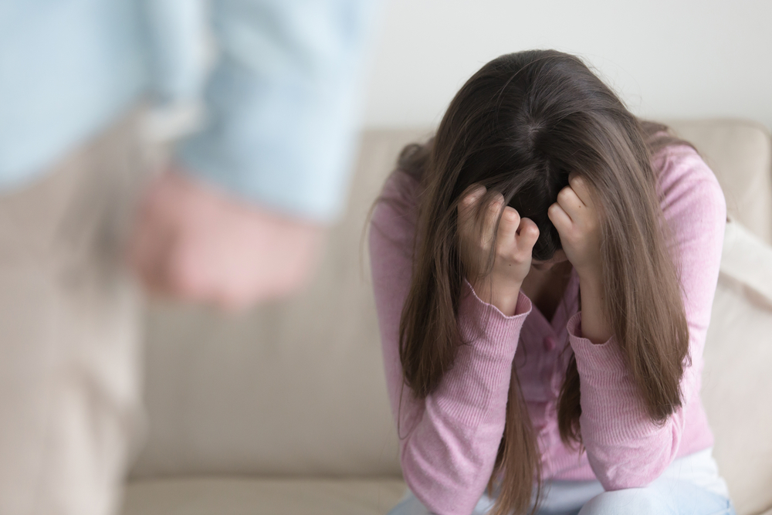
Inner Critic
“The inner critic is an internal voice that commands and sends negative messages” (Elliott, 1992).
Words: accusatory and/or attacking
Tone: harsh, angry and/or disappointed
Feelings: failure, shame, guilt and/or fear

Slide 26
Three Types of Messages
“you should”
Disapproving thoughts, feelings and/or behaviours
Negative predictions about ability and/or future
Possible cause:
Children with parents who are highly critical, control and performance focused will be more self-critical as adults (McCranie & Bass, 1984; Whiffen & Sasseville, 1991).

Slide 27
There Are Consequences
Individuals who score high on self-criticism:
→ Have less friends and less satisfied with social support (Moskowitz & Zuroff, 1991) → Use more negative communication after a stressful event (Santor, Pringle, & Israeli (2000) → Report lower levels of trust + share a low amount of personal information (Zuroff & Fitzpatrick, 1995)

Slide 28
Self-Compassion
Self-compassion is simply compassion directed inward, relating to ourselves as the object of care and concern when faced with the experience of suffering:
“I tried my best.” “I learned something.” “Next time, we do it differently.”

Slide 29
“We see the world not as it is, but as we are.” - Stephen Covey

Slide 30
Resilience
A reactive state that is impacted by the previous three capabilities.

Slide 31
re·sil·ience Resiliency is one's capacity to cope successfully in the face of significant change, adversity, risk, or even increased responsibility. Resilient individuals can actually thrive and grow through setbacks and difficulties. When faced with hardship, resilients bounce back to higher levels of performance than before, and they find meaning and value in the process. (Peterson, Balthazard, Waldman and Thatcher, 2008).

Slide 32
What matters is what you say after…

Slide 33
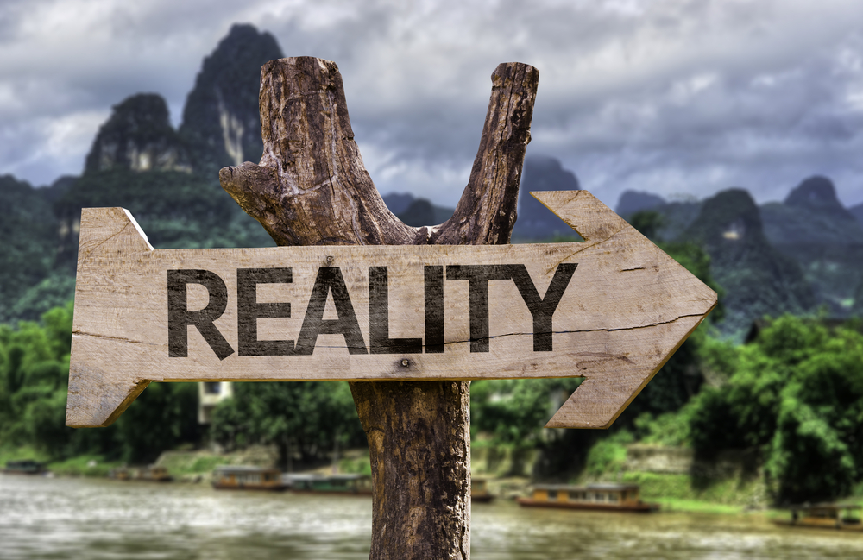
Resilience and Reality Testing
It’s not about positive thinking or negative thinking. Instead, it’s about accurate thinking.
Resilients are logical in their interpretations of setbacks - what is in their control, out of their control, and options for taking action. (Peterson, Balthazard, Waldman and Thatcher, 2008).

Slide 34

Flexibility
Flexibility focuses on the ability to adapt to an unpredictable environment.
`
It requires being responsive to change in a constructive way.

Slide 35
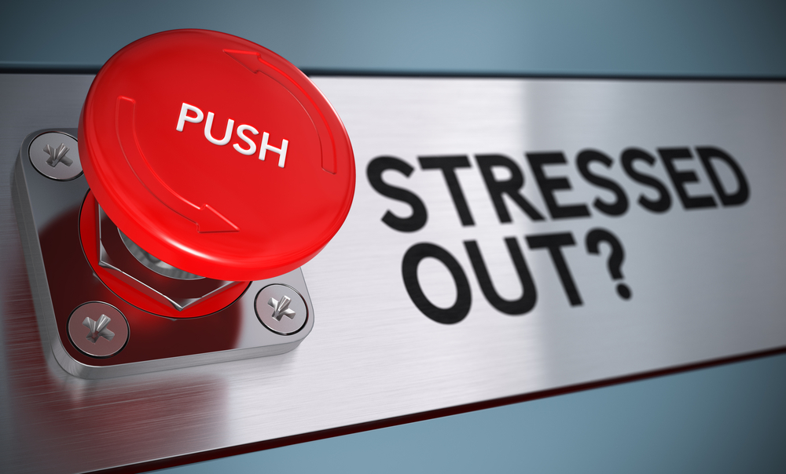
Stress Tolerance
Focuses on coping and responding to stress in an effective way.
Athlete analogy: Do you take the time to recover?
Do you have a plan?

Slide 36
“It is not stress that kills us; it is our reaction to it.” – Hans Selye

Slide 37
Optimism
Based on Martin Seligman’s work in Positive Psychology

Slide 38

Optimism
How do you view challenging situations?
Optimism is a protective measure against helplessness
Learned Optimism: Realistically challenge pessimistic thoughts

Slide 39

Happiness+ Resilience
Self-Regard (Efficacy)
Self-Actualization (Hope)
Optimism
Interpersonal Relationships

Slide 40
“Be happy for this moment. This moment is your life.” – Omar Khayyam

Slide 41

w: viewpointleadership.ca | e: rbillan@viewpointleadership.ca | t: @RumeetBillan

